Slide 1
Security Session 12
Course : COMP6153
Effective Period : September 2018

Slide 2
Sub Topics
System Access Threarts
Inruders
Malicious Program
Authentication
Access Control

Slide 3
These slides have been adapted from: Stallings, W. (2011). Operating Systems: Internals and Design Principles. 8^{th.} ISBN: 978-0-13-380591-8 Chapter 14
Acknowledgement

Slide 4
Learning Objectives
At the end of this lecture, students are able to:
LO1 : List and Explain key conceps that comprise Computer Security
LO2: Present an overview of various types of intrusions
LO3 : Apply different strategies prevent indtrusion/virus
LO4 : Understand the programming aspect of computer security

Slide 5
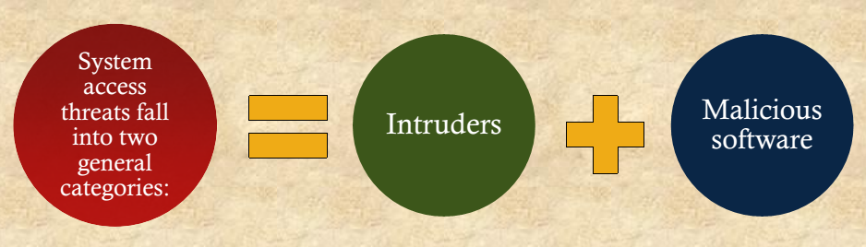
System Access Threats

Slide 6
Computer Assets
The assets of a computer system can be categorized as
hardware,
software,
data,
communication lines and networks.

Slide 7
Intruders
Masquerader
an individual who is not authorized to use the computer and who penetrates a system’s access controls to exploit a legitimate user’s account
Misfeasor
a legitimate user who accesses data, programs, or resources for which such access is not authorized, or who is authorized for such access but misuses his or her privileges
Clandestine User
an individual who seizes supervisory control of the system and uses this control to evade auditing and access controls or to suppress audit collection

Slide 8
Malicious Software
Programs that exploit vulnerabilities in computing systems
Also referred to as malware
Can be divided into two categories:
Parasitic
fragments of programs that cannot exist independently of some actual application program, utility, or system program
viruses, logic bombs, and backdoors are examples
independent
self-contained programs that can be scheduled and run by the operating system
worms and bot programs are examples

Slide 9
Malware
General term for any Malicious softWare
Software designed to cause damage
Or use up the resources of a target computer.
Some malware is parasitic
Contained within other software
Some malware is self-replicating, others require some other means to propagate.

Slide 10
Backdoor
Trapdoor
Secret entry point
Useful for programmers debugging
But allows unscrupulous programmers to gain unauthorized access.

Slide 11
Logic Bomb
Explodes when certain conditions are met
Presence or absence of certain files
Particular day of the week
Particular user running application

Slide 12
Trojan Horse
Useful program that contains hidden code that when invoked performs some unwanted or harmful function
Can be used to accomplish functions indirectly that an unauthorized user could not accomplish directly
User may set file permission so everyone has access

Slide 13
Parts of Virus
Software that “infects” other software by modifying them
Modification includes
An infection mechanism
Trigger
Payload

Slide 14
Virus Stages
During its lifetime, a typical virus goes through the following four phases:
Dormant phase
Propagation phase
Triggering phase
Execution phase

Slide 15
Worms
Replicates itself
Use network connections to spread form system to system
Email virus has elements of being a worm (self replicating)
But normally requires some intervention to run, so classed as a virus rather than worm

Slide 16
Bots
From Robot
Also called Zombie or drone
Program secretly takes of another Internet-attached computer
Launch attacks that are difficult to trace to bot’s creator
Collection of bots is a botnet

Slide 17
Rootkit
Set of programs installed on a system to maintain administrator (or root) access to that system
Hides its existence
Attacker has complete control of the system.

Slide 18
Rootkit classification
Rootkits can be classified based on whether they can survive a reboot and execution mode.
Persistent
Memory based
User mode
Kernel mode

Slide 19
Rootkit installation
Often as a trojan
Commonly attached to pirated software
Installed manually after a hacker has gained root access

Slide 20
Authentication
An authentication process consists of two steps:
identification step
presenting an identifier to the security system
verification step
presenting or generating authentication information that corroborates the binding between the entity and the identifier

Slide 21
Means of Authentication
Traditionally listed as three factors
Something you know
Password, PIN
Something you have
Card, RFID badge
Something you are
Biometrics

Slide 22
Static Biometric Authentication
Includes
Facial characteristics
Fingerprints
Hand geometry
Retinal pattern
Based on pattern recognition,
technically complex and expensive.

Slide 23
Dynamic Biometric Authentication
Patterns may change
Includes
Iris
Signature
Voice
Typing rhythm

Slide 24
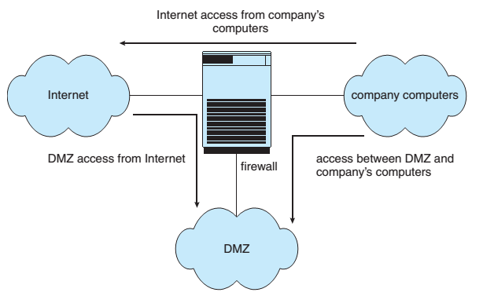
Firewall to Protect Systems
Silberschatz, Gavin and Gagne: Operating Ssystems Concept

Slide 25
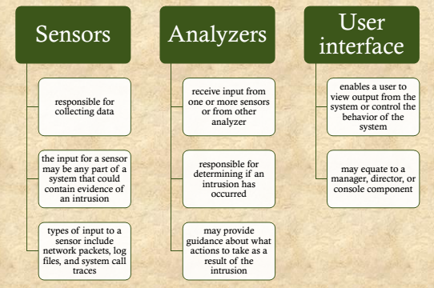
Intruder Detection System
Components

Slide 26
File System Access Control
Identifies a user to the system
Associated with each user there can be a profile that specifies permissible operations and file accesses
The operating system can then enforce rules based on the user profile
The database management system, however, must control access to specific records or even portions of records
The database management system decision for access depends not only on the user’s identity but also on the specific parts of the data being accessed and even on the information already divulged to the user

Slide 27
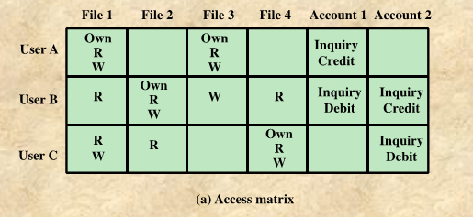
Access Control Matrix

Slide 28
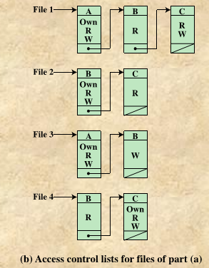
Access Control List

Slide 29
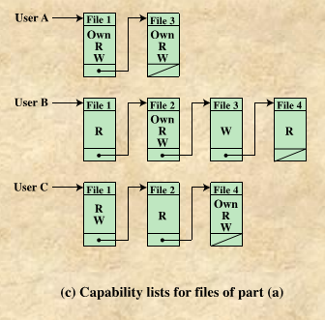
Capability List

Slide 30
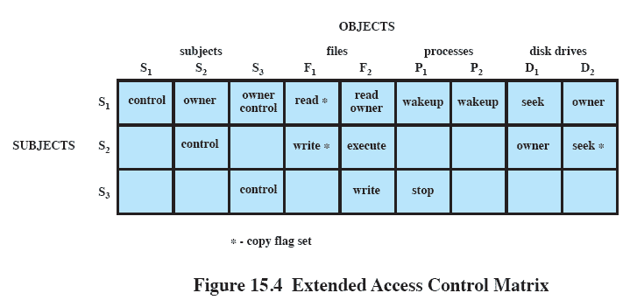
Extended Access Control Matrix

Slide 31
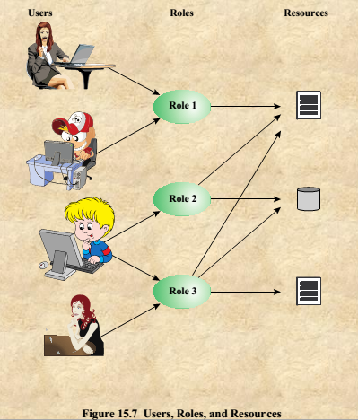
Users, Roles and Resources

Slide 32
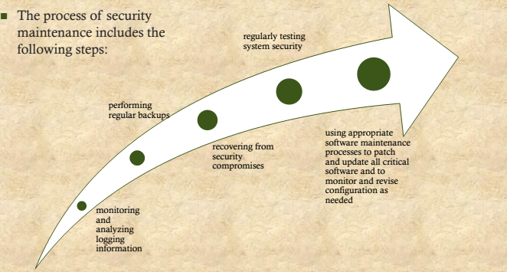
Security Maintenance

Slide 33
Logging
Effective logging helps ensure that in the event of a system breach or failure, system administrators can more quickly and accurately identify what happened and more effectively focus their remediation and recovery efforts
Logging information can be generated by the system, network, and applications
The range of logging data acquired should be determined during the system planning stage
Logging can generate significant volumes of information so it is important that sufficient space is allocated for them
A suitable automatic log rotation and archive system should be configured to assist in managing the overall size of the logging information
Some form of automated analysis is preferred as it is more likely to identify abnormal activity

Slide 34
References
Stallings, W. (2014). Operating Systems: Internals and Design Principles. 8^{th.} ISBN: 978-0-13-380591-8

